Slide 1

Technology Analysis Presentation
--Yutong Hou
2/1/2024

Slide 2
Executive Summary
Trends in programming languages and databases
Demographics survey
Technological gap in countries
Gender gap in jobs

Slide 3
Introduction
About:
Analyzing the trends in softwaredevelopment
Purpose:
Identify skill requirements for future
What are the top programming languagesin demand?
What are the top database skills indemand?
What are the popular IDEs
Audience: Human Resource and IT Head

Slide 4
Methodology
Data Collection Sources
•Stack Overflow Developer 2019 Survey
•GitHub Job Postings
•Programming Languages Annual Salary
•Data Exploration
•Data Cleaning
•Data Visualization
•Presentation

Slide 5
PROGRAMMING LANGUAGE TRENDS

Slide 6
PROGRAMMING LANGUAGE TRENDS -FINDINGS & IMPLICATIONS
Findings
•JavaScript, HTML/CSS, SQL aretop 3 this year
•Python and Typescript becomingpopular next year
•PowerShell edged out in nextyear
Implications
•Web development are still inhigh demand
•Big Data technology incompanies still requires SQL
•With AI and ML in risingdemand, Python is best choice

Slide 7
DATABASE TRENDS

Slide 8
DATABASE TRENDS -FINDINGS & IMPLICATIONS
Findings
•MySQL most popular
•Behind is Microsoft SQL
•MongoDB and Redis areupcoming favorites
•New kid on the block:Elasticsearch
Implications
•Open source databases are stillpreferable in companies
•NoSQL databases will make animpact for storing non relationaldata
•Redis supports abstract datatypes
•Pre tuned search to website,app, or ecommerce store

Slide 9
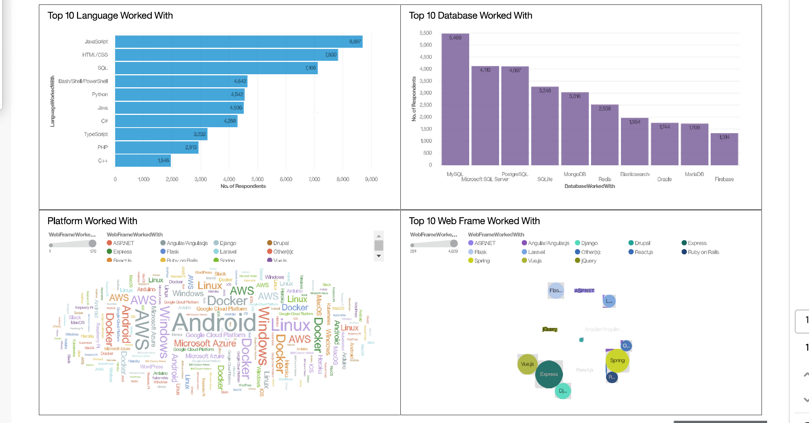
DASHBOARD TAB 1

Slide 10
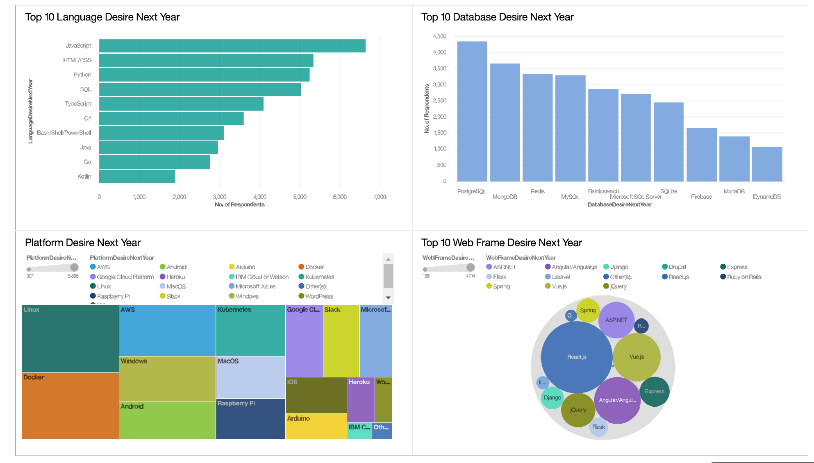
DASHBOARD TAB 2

Slide 11
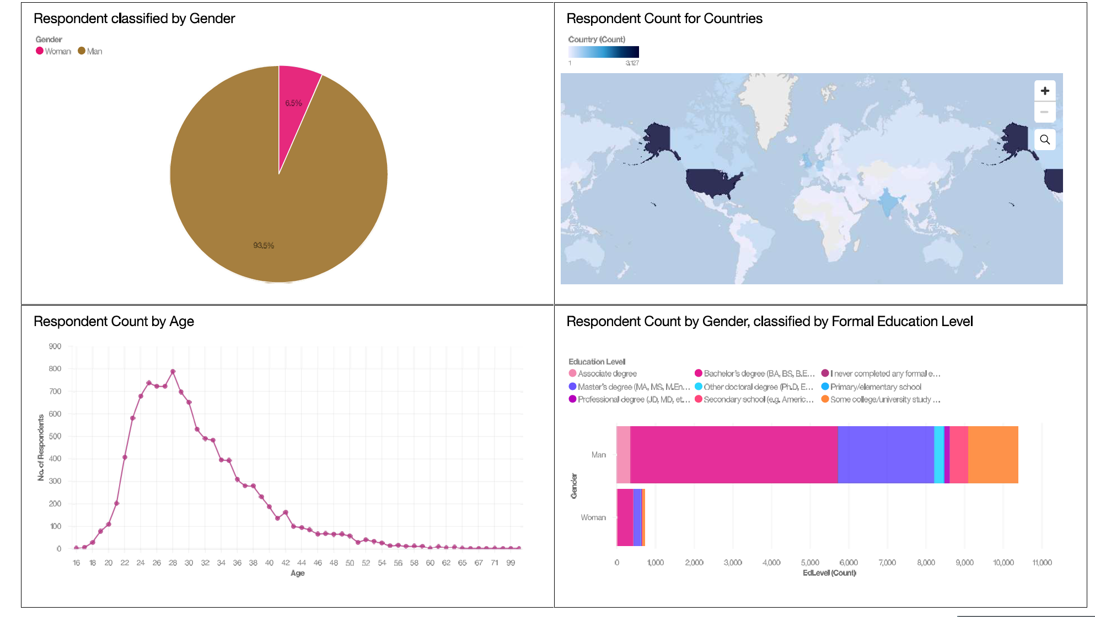
DASHBOARD TAB 3

Slide 12
Discussion
Findings
•Fast changing technology everyyear
•Concentration on severalcountries like USA and India
•Gender gap in technology jobs
•Platforms like Docker and AWSare growing
Implications
•Companies need to be flexible and adjust to rapid changes
•Need to spread technology out to lagging countries
•Impact of job hiring’s
•Shift to faster app deployments and cloud services in future

Slide 13
Conclusion
TechnologyTrends for current and next year
•Programming Languages, Database and Platform overview
•Demographics overview
•Actions to be taken
•In future, incorporate Machine Learning to predict trends and salaries

Slide 14
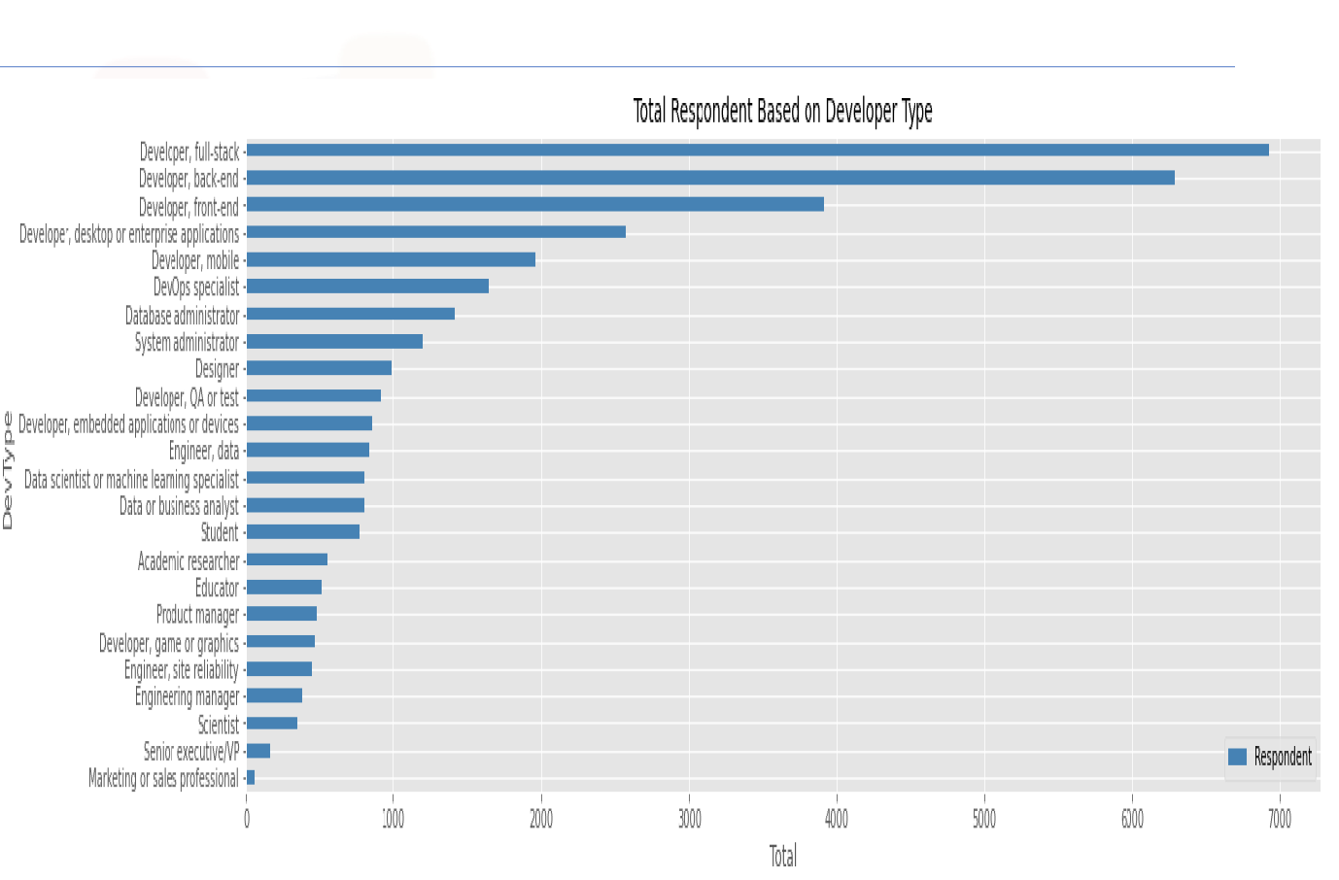
Appendix

Slide 15
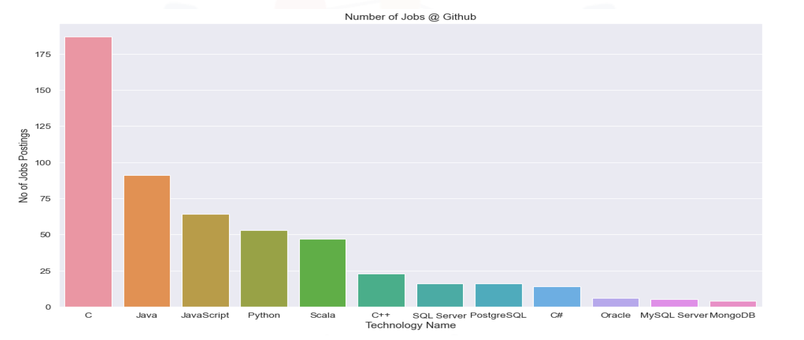
GITHUB JOB POSTINGS

Slide 16
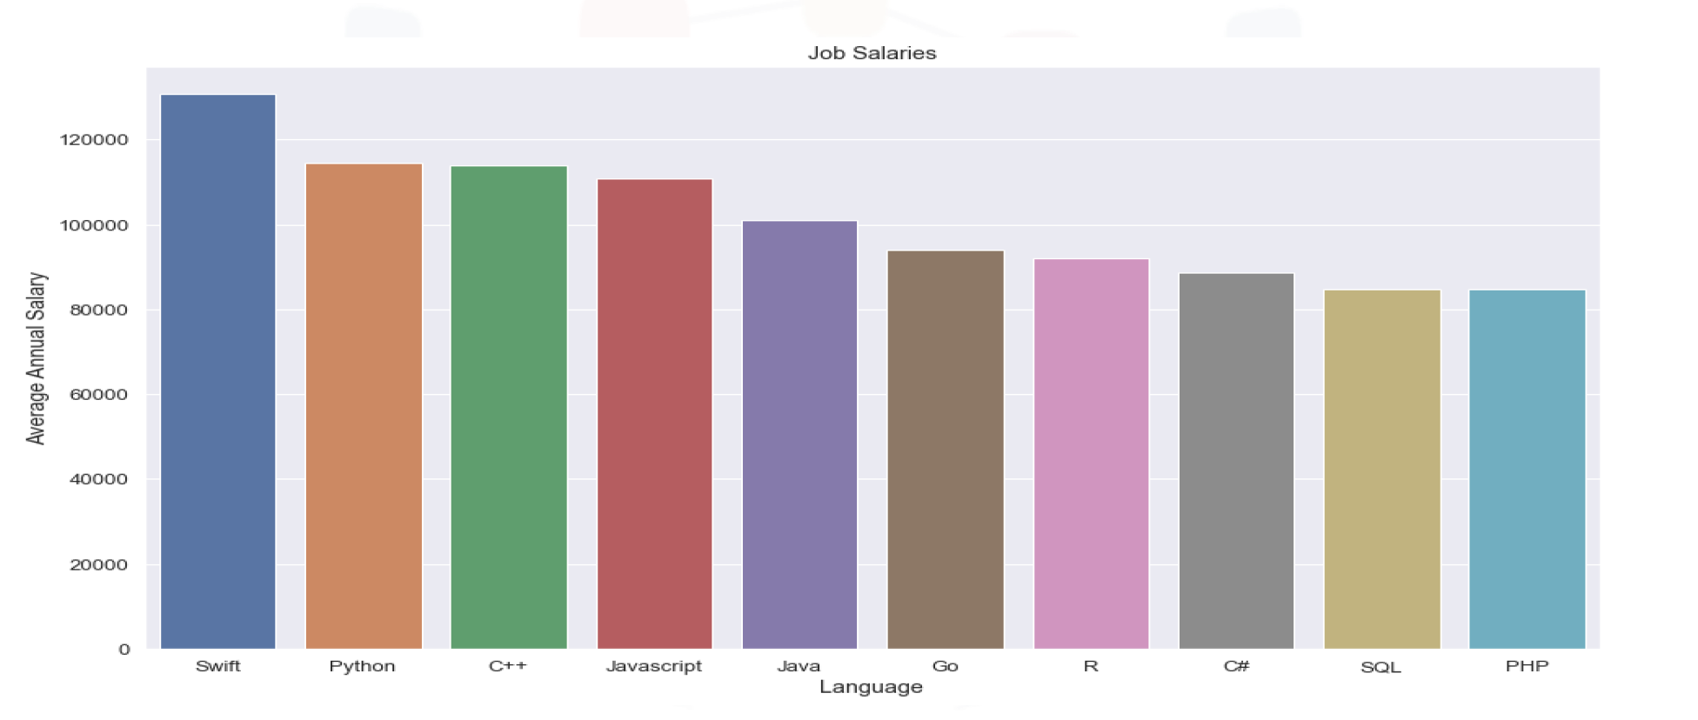
POPULAR LANGUAGES

